Slide 1
Ethics
CS 404

Slide 2
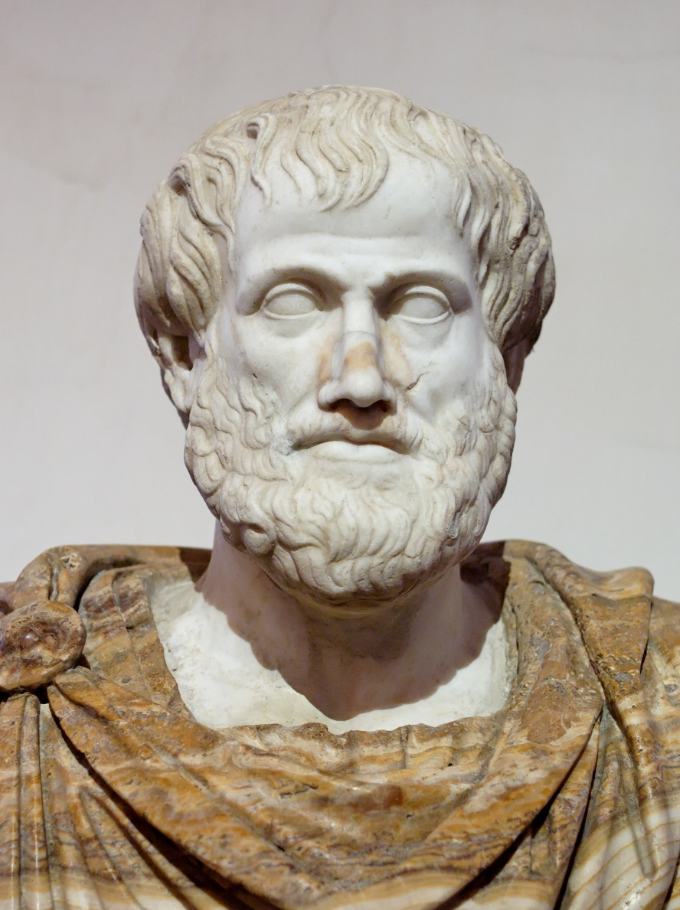
Foundation
Aristotle
384 – 322 BC, Classical Greece
Student of Plato
Tutor of Alexander the Great
Considered the father of modern ethics

Slide 3
Foundation
Considered ethics to be a practical rather than a theoretical study.
The aim being: becoming good and doing good rather than merely knowing for its own sake.
Knowing ≠ doing.
Knowing ≠ being.

Slide 4
Foundation
Identified the “optimum activity of the soul” as the aim of all human deliberate action (eudaimonia, generally translated as “happiness” or sometimes “well being”)

Slide 5
Foundation
To have the potential of ever being happy in this way necessarily requires a good character (ēthikē aretē), often translated as moral (or ethical) virtue (or excellence).
moral virtue
ethical excellence
ēthikē → ethics
Etymology: Ethics - From Old French ethique, from Late Latin ethica, from Ancient Greek ἠθική (ēthikē), from ἠθικός (ēthikos, “of or for morals, moral, expressing character”), from ἦθος (ēthos, “character, moral nature”).

Slide 6
Foundation
Taught that to achieve a virtuous and potentially happy character requires a first stage of having the fortune to be habituated by teachers and experience, leading to a later stage in which one consciously chooses to do the best things.
The disposition to “act excellently” is developed by a person partly as a result of upbringing and partly as a result of his/her own habit of action (conscious choice).

Slide 7
Foundation
The main three questions posed by philosophy are:
What is reality?
How do we know what we know?
Given what we know, what should we do?
These questions correlate to three branches of philosophy:
Metaphysics
Epistemology
Ethics

Slide 8
Definition
Ethics
Morality
moral principles that govern a person's or group's behavior
systematizing, defending, and recommending concepts of right and wrong conduct
a system of principles concerning right and wrong behavior that is accepted by a particular group of people
conformity to ideals of right human conduct

Slide 9
Ethics vs. Morality
Is there a difference?
The distinction that is frequently used in modern philosophical circles is that morality is a claimed objective and divinely inspired position from a transcendent source, whereas ethics is immanent in human practice and responsive to the contingencies and vicissitudes of living.
In other words,
morality is considered to be religious and immutable in nature (though not necessarily agreed upon by all—not everyone has the same religious beliefs), and
ethics is considered to be secular and situational in nature (therefore, everyone should accept it).
This is clearly a modern distinction that did not originate with Aristotle. In fact, Aristotle would not have agreed with that distinction. For Aristotle, ethics and morality were one and the same.
Why has this distinction arisen? Does it say something about the state of our modern society?

Slide 10

Ethics vs. Morality
The better way to parse the difference between morality and ethics is to say that:
Morality is the common, everyday evaluation of whether a behavior is socially acceptable.
Ethics is the critical reflection on personal and social morality.
Groups and societies have moral expectations just as individuals have moral judgments.
Equating morality with the individual and ethics with society makes it impossible to see that some social arrangements are immoral and that groups as a whole can be morally wrong.
Perhaps this is intentional? If so, why might that be?

Slide 11
Conclusion
Hence, the study of ethics is about the philosophical process of answering ‘Given what we know, what should we do?’
Morality, Aristotle’s “good character” (ēthikē aretē), is the answer.

Slide 12
Reflection
“An ethical man follows, while a moral man acts.”
“The difference from a moral man and an ethical man: an ethical man knows it is wrong to cheat on his wife; however, a moral man wouldn't.”
Knowing ≠ doing.
Knowing ≠ being.

Slide 13
Reflection
Ethics is a philosophical inquiry. Morality is a human characteristic.
The commonality is that ethics is a study of that human characteristic. All humans live by some kind of code that determines right action. Without such a code, decision would be impossible. Therefore, morality has existed since the dawn of man. Ethics—the philosophical inquiry—began with Aristotle.

Slide 15
Gospel of Jesus Christ
Light of Christ
Holy Ghost & Personal Revelation
Prophets
Scriptures

